Slide 1
Successful Presentations a-z
Tim Thompson
Archer English Consulting

Slide 2
A
Audience
Your audience is your customer.
Treat them with respect.
Notes:
Your audience you also include future customers, employees, or partners.

Slide 3
Who might attend your presentation?
A department head/lab manager who is recruiting new talent
Representatives from similarly-ranked universities
Representatives from industry
Representatives from grant-providing organizations
VCs
Your future collaborator
Your future spouse

Slide 4
B
Busy slides
Busy slides make it hard for the audience to listen
to you while they are reading all your content.

Slide 5
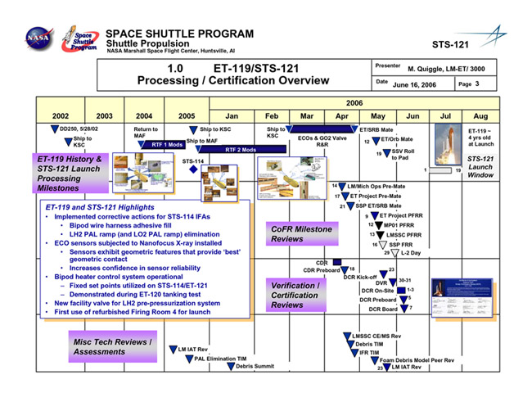

Slide 6
C
Calm down
The audience wants you to succeed.
Find some friendly faces and talk to them.

Slide 7
D
Delivery
Delivery errors distract the audience
from focusing on your content.

Slide 8
Aspects of delivery
Eye contact
Eye rotation
Speaking volume
Speaking speed
Vocabulary choices/idiomatic language
Body language
Facial expressions

Slide 9
E
Edit your slides
Errosr on your slides can damage you’re credibility.

Slide 10
E
Edit your slides
Errors on your slides can damage your credibility.

Slide 11
F
Flexibility
Be prepared to adjust to unforeseen circumstances. No one knows what you are planning to say.

Slide 12
G
Goals
Goals help you craft better proposals
and design stronger presentations.

Slide 13
H
Hooks
Hooks are a tool that give the audience
members a reason to pay attention to you.

Slide 14
Types of hooks
1. Skills improvement
“By learning about more about x, you will be able to accomplish y.”
2. Promising value
“By understanding how x works you will be able to do y faster and cheaper.”
3. Breakthroughs
“In the past, it took 10 seconds for the gas to be detected but now it takes .001 seconds.”
4. The newest/latest
“We have developed the fastest microchips on the market and I’m going to explain how we did it.”

Slide 15
I
Introductions
Introductions are an opportunity for you
to make a strong first impression.

Slide 16
Four elements of a complete introduction
1. Introduce yourself
“Good afternoon. My name is Tim Thompson.”
2. Explain your connection to the topic
“I’ve been teaching presentation skills in Korea for more than ten years.”
3. Introduce your topic
“Today I’m going to share some tips for giving better presentations.”
4. Hook the audience
“This will help you make a positive impression and reach your goals.”

Slide 17
J
Jokes
Jokes may not be appropriate and there
might not be time for small talk.

Slide 18
K
Keep a professional mask
Keep your poker face when you
get lost or make a mistake.

Slide 20
L
L2
Second languages can lead to communication breakdowns.
KISS (keep it short and simple) whenever possible.

Slide 21
M
Manage your time
Going over your time tells people that
you do not value their time.

Slide 22
N
Networking
Don’t just attend conferences for the sessions.
Bring lots of business cards.

Slide 23
O
Observe other presenters
Observe what you like and don’t like from other presentations
and incorporate what you learned into yours.

Slide 24
P
Power
Embrace the power.
The audience will wait if you need to pause.

Slide 25
Silence in between teachers' remarks is a very important part of a lecture. Silences provide time for consolidation and thought. Their timing requires the skill of an actor. They are useful after rhetorical questions or when a problem has been posed and, provided attention is maintained, they may need to be longer in the third quarter of a lecture, where interference is greatest. Interference is probably the chief cause of forgetting in lectures, particularly when the lecture is too fast.
Donald A. Bligh
What’s the Use of Lectures?

Slide 26
Q
Q&A
Q&A can be scary but can also be manageable,
especially if you learn to anticipate questions.
Notes:
Why X and not Y?

Slide 27
Delaying Tactics During Q&A
1. Ask for clarification
“Let me clarify, are you asking if …?”
2. Use an aside
“Great question. That’s reminds me…”
3. Admit what you don’t know
“I don’t have that in front of me but I will email you when I get back to my lab.”
4. Don’t waste time on questions for only one audience member
“That’s very specific. Could we discuss it afterwards? Great! Now, are there any more general questions?”

Slide 28
R
Reading
Reading your slides on the big screen or from a script
gives the audience permission to stop listening.

Slide 29
S
Smile!
Smiling shows confidence and makes the
audience want to like and support you.

Slide 30
T
Technical Posters
Don’t start explaining from the top.
Put the WOW before the HOW.

Slide 31
U
Understand the tech
Understand how to use the microphone, remote controls,
and projector before your talk begins.

Slide 32
V
Videos
Videos can be an effective ways to “show instead of tell”
but be sure to test that they work in advance.

Slide 33
W
Watch the audience
Their facial expressions and body language
will let you know how you are doing.

Slide 35
X
Don’t slip slides.
Summarize the key point of each slide
if you need to finish faster.

Slide 36
Y
Your nervous energy
Turn the adrenaline into enthusiasm and a high energy
level instead of letting it hold you back.
Notes:
Use Kelly McGonigal TED Talk info https://www.health.harvard.edu/staying-healthy/understanding-the-stress-response

Slide 37
Z
ZZZ
This is what your audience will be doing
if you don’t follow these presentation tips.

Slide 38
Now you know
Presenting A to Z
Applying these tips will help your next presentation
have more successful outcomes.

Slide 39
Need more tips?
Visit my blog
timthompsonelt.com

